Slide 1
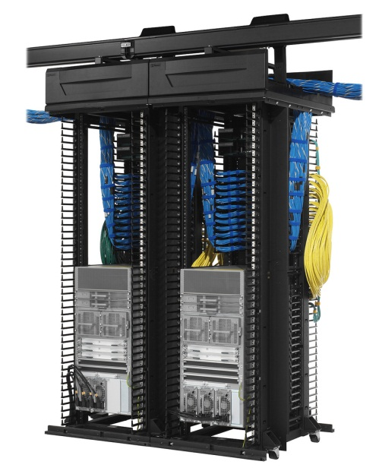

Switching Concepts
VLAN, TRUNK, DTP, VTP, Port Security

Slide 2

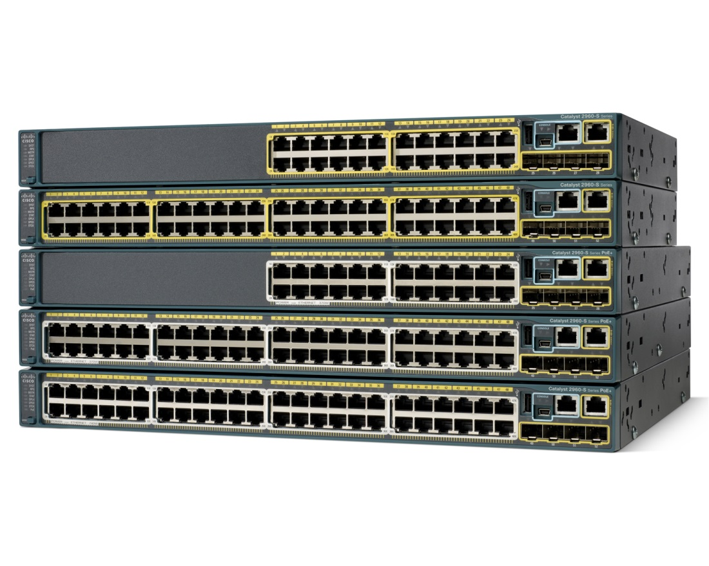
Switching Concepts
What is Switch?
HUB
Bridge
Switch
Collision Domain
Broadcast Domain
CSMA/CD
Interface characteristic
Speed
Duplex

Slide 3
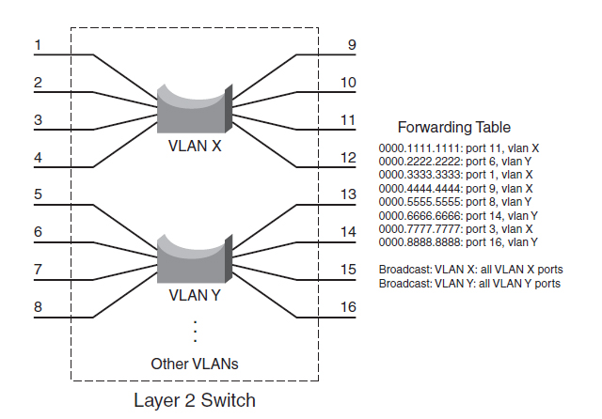
Switching Concepts
CCNA (Cisco Certified Network Associate)
Packet Forwarding
Ethernet (IEEE 802.3)
MAC address
Store and Forward
Cut Through
Fragment free
Packet Types
Unicast
Broadcast
Unknown unicast
802.3x (1997)
7 | 1 | 6 | 6 | 2 | 1 | 1 | 2 | 46~1500 | 4
Preamble | SOF | DMAC | SMAC | Type/Length | DSAP | SSAP | Control | Data | FCS
802.2

Slide 4
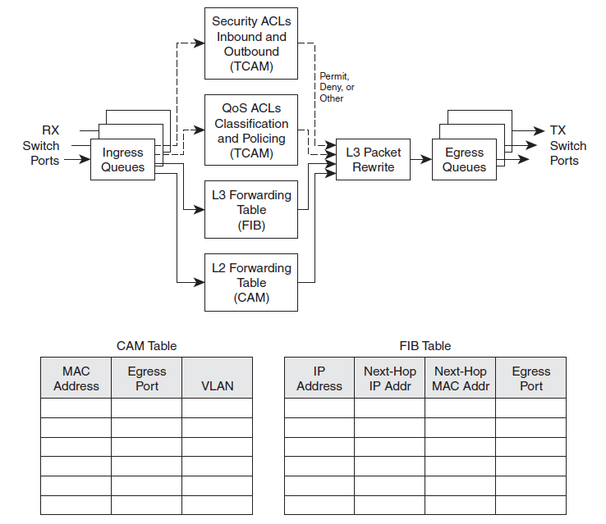
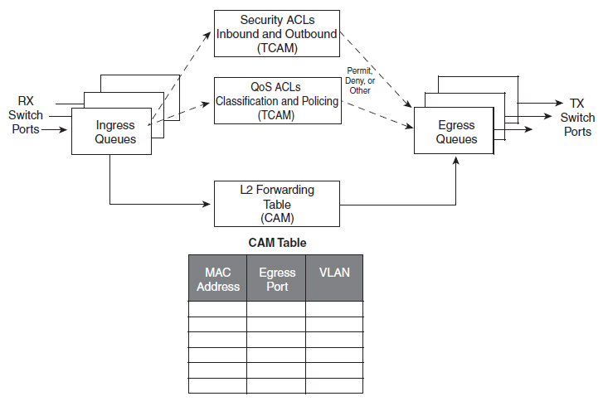
Switching Concepts
Switching Components
Content Addressable Memory (CAM)
Ternary Content Addressable Memory (TCAM)
Forwarding Information Base (FIB)

Slide 5
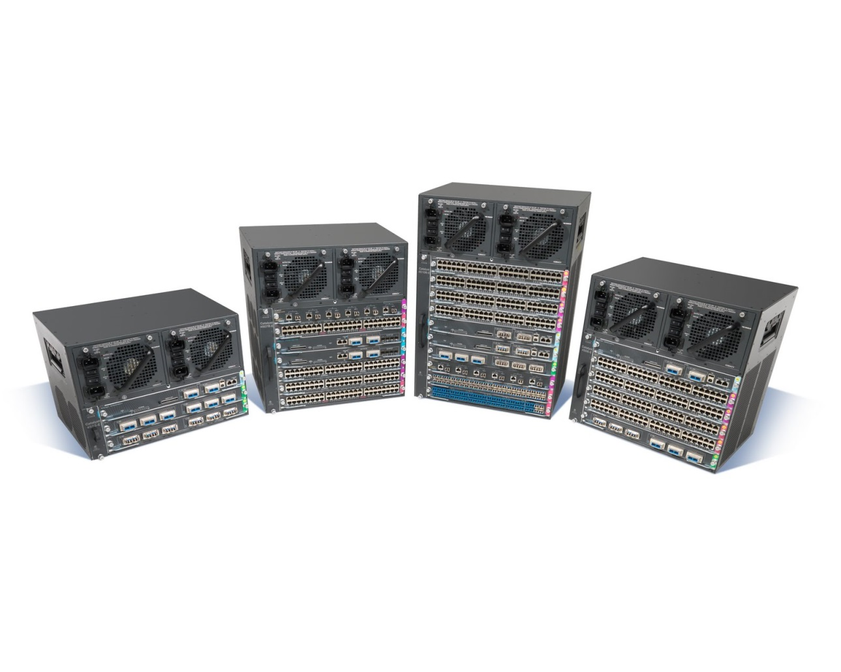
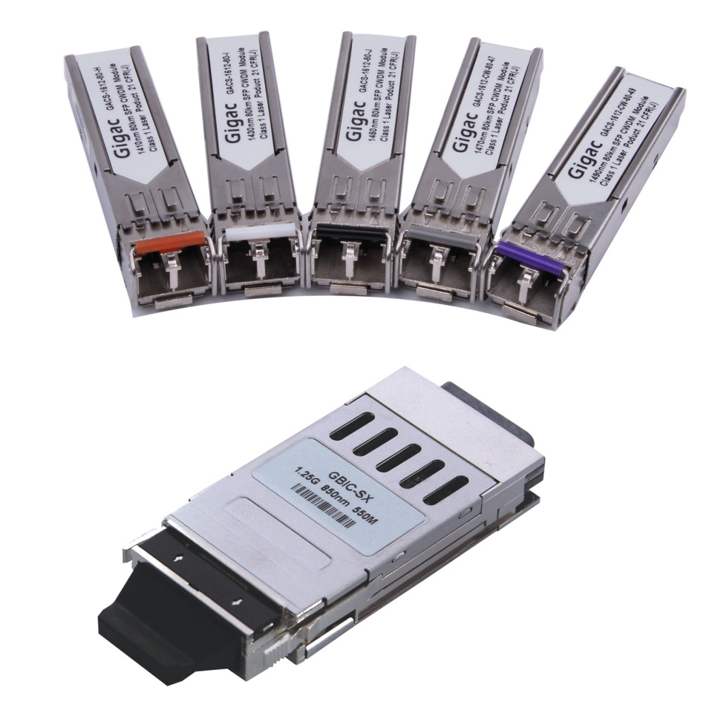
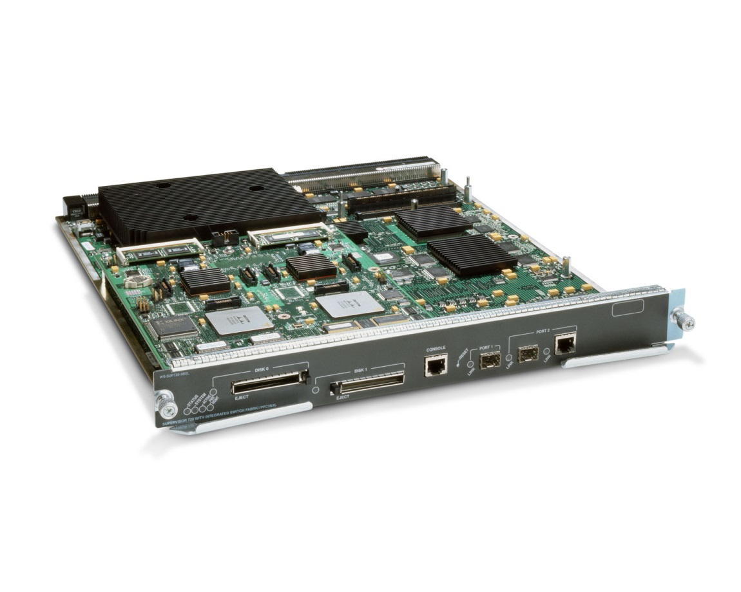
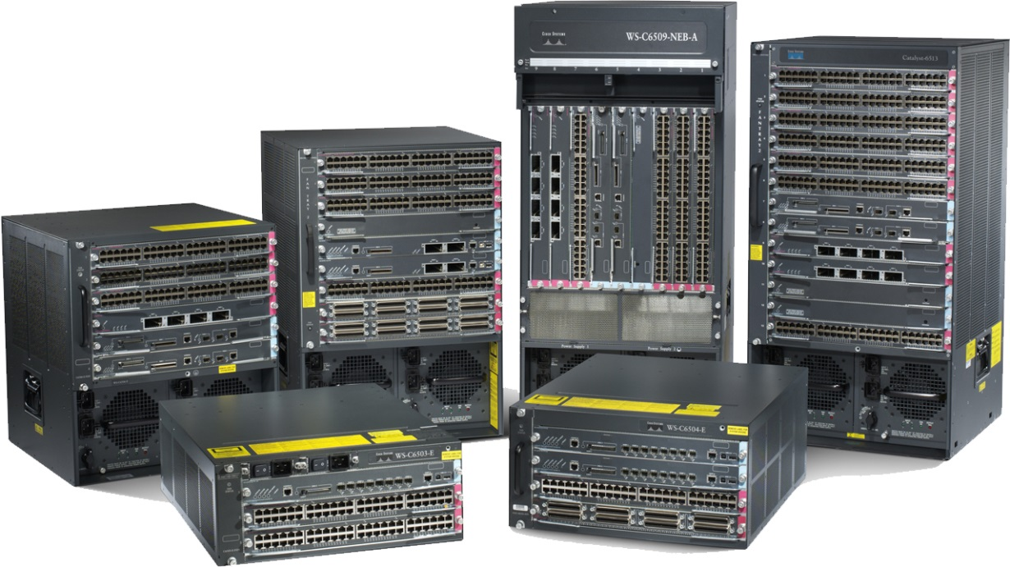
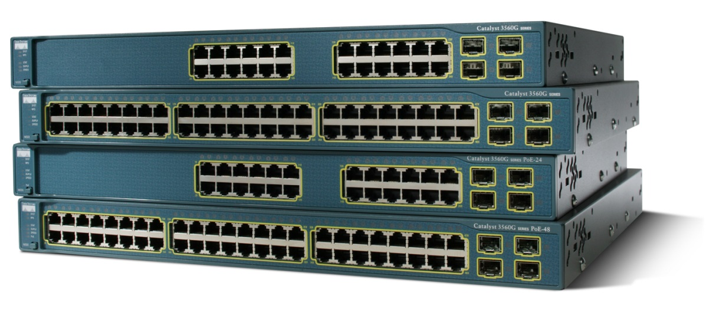
Switching Concepts
Switch Types
Layer 2 Switches
Multilayer Switches
Modular Multilayer Switches
Switch Modules
Supervisor Engine
Line Cards
SFP
GBIC

Slide 6
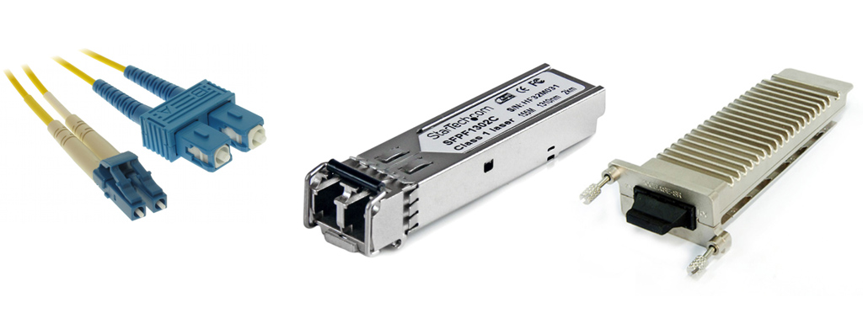
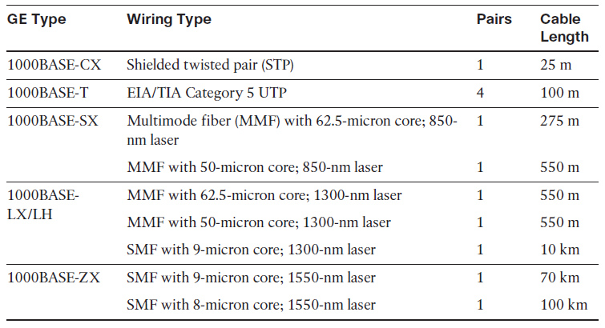
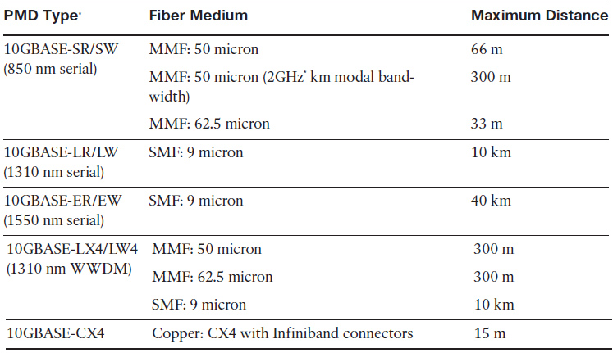
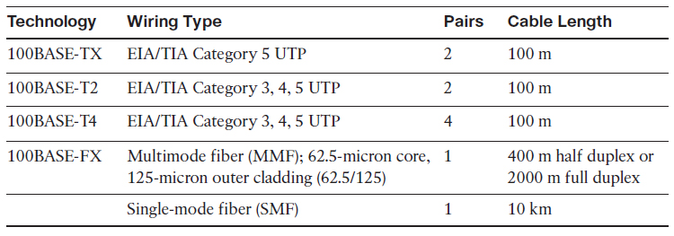
Switching Concepts
Ethernet Technology
Ethernet (IEEE 802.3) (10Mbps)
Fast Ethernet (IEEE 802.3u) (100Mbps)
Gigabit Ethernet (IEEE 802.3z , 802.3ab) (1Gbps)
10Gigabit Ethernet (IEEE 802.3ae, 802.3an) (10Gbps)
Switch Modules
SFP
GBIC
XENPAK
X2
SFP+

Slide 7
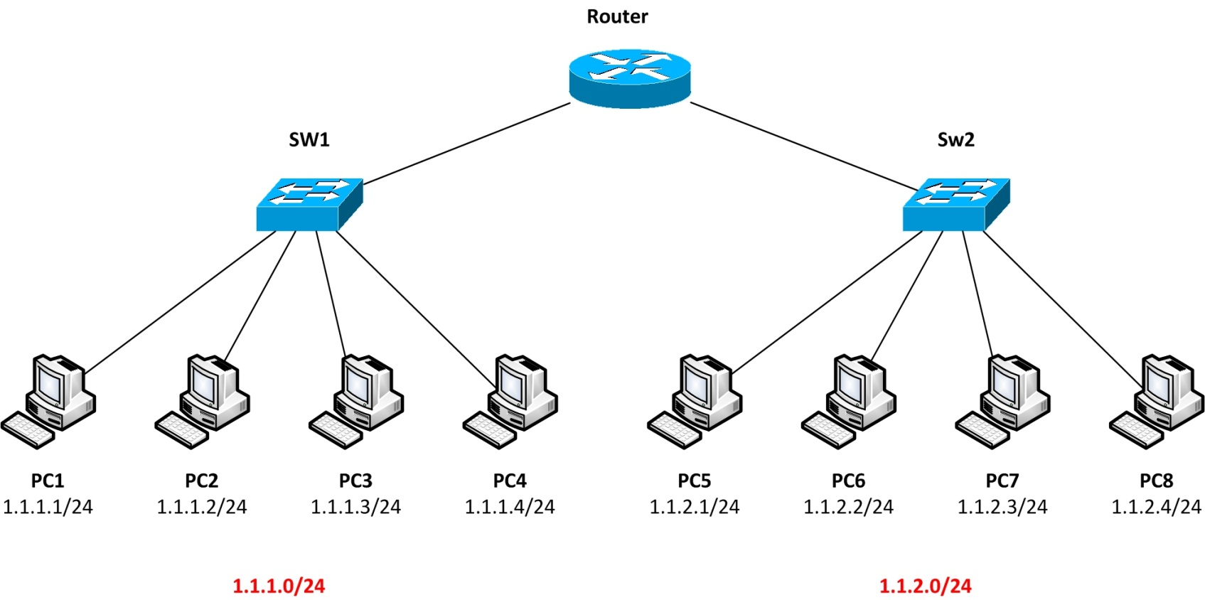
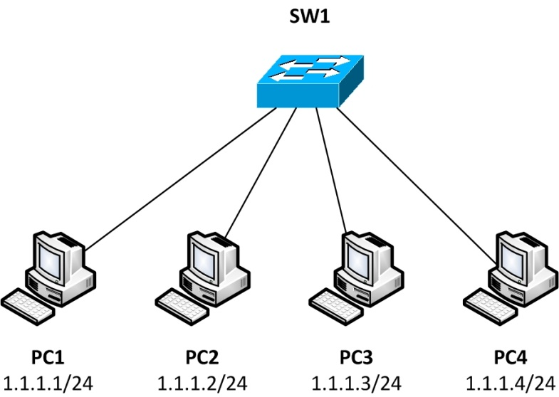
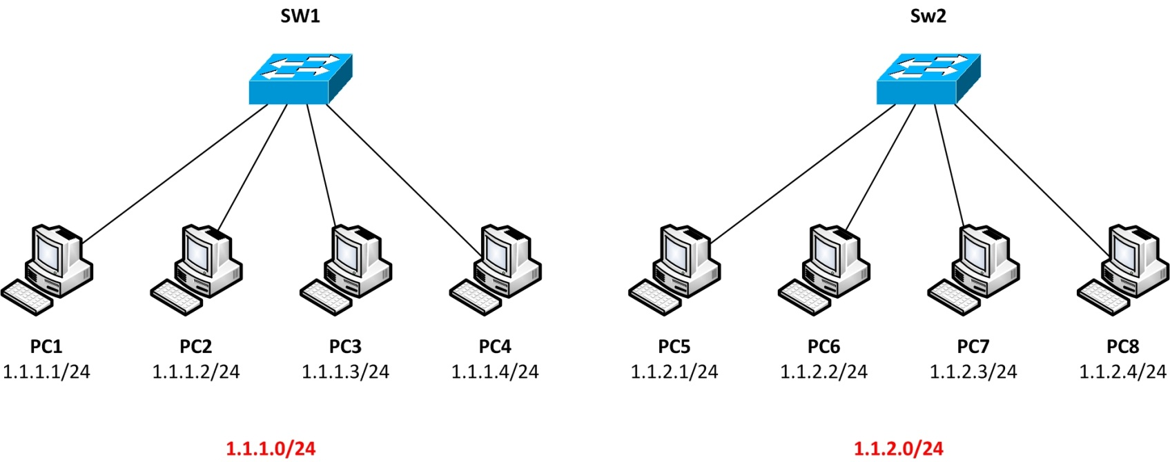
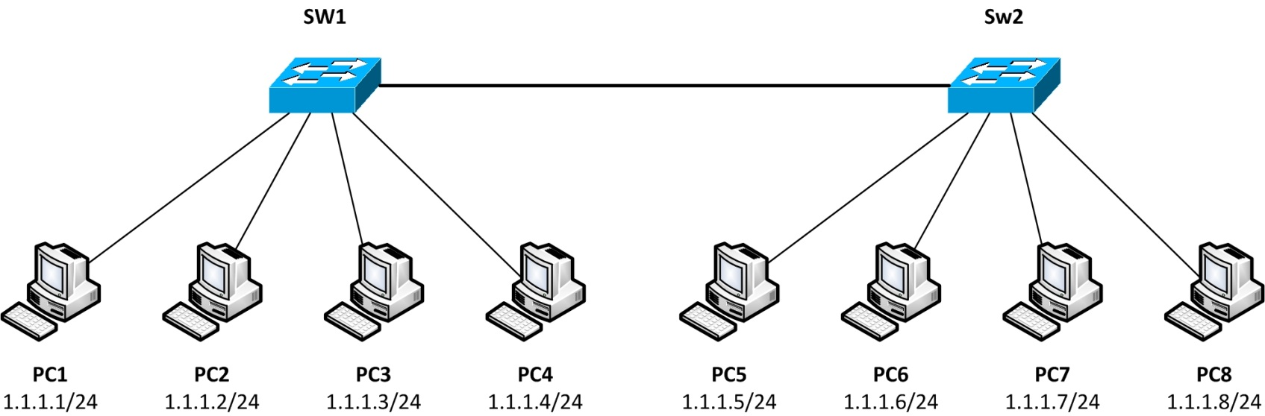
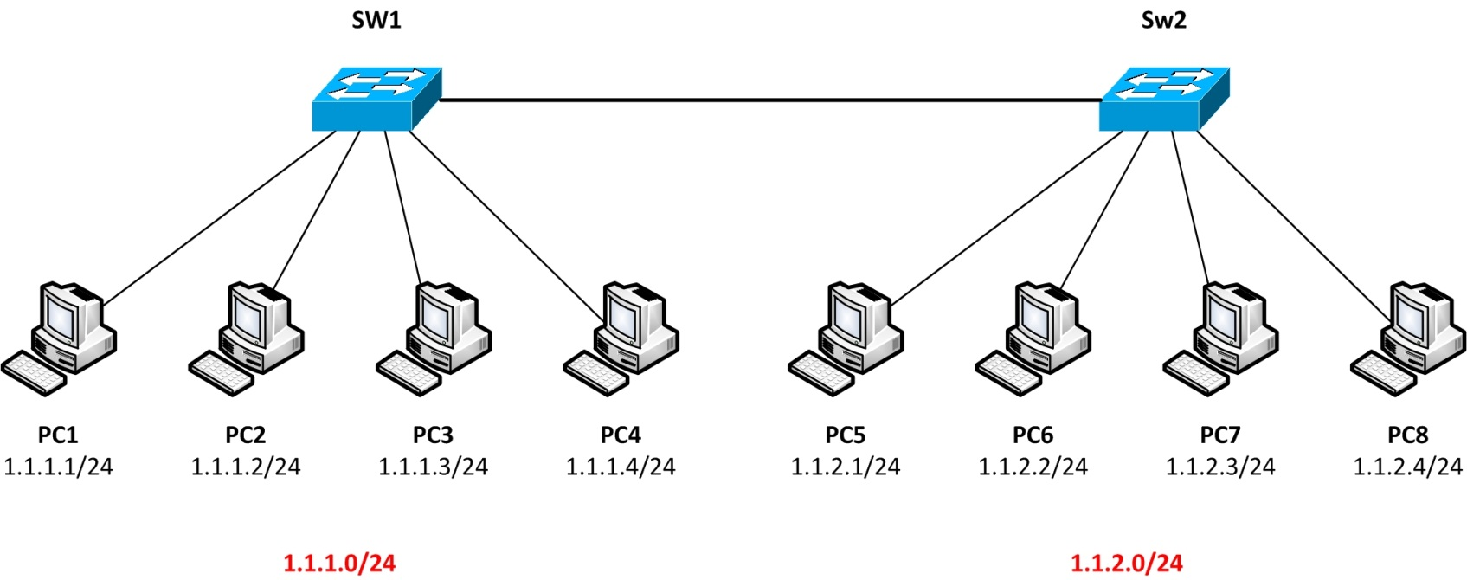
Switching Concepts
What is LAN?
Same Broadcast Domain
Same Subnet

Slide 8
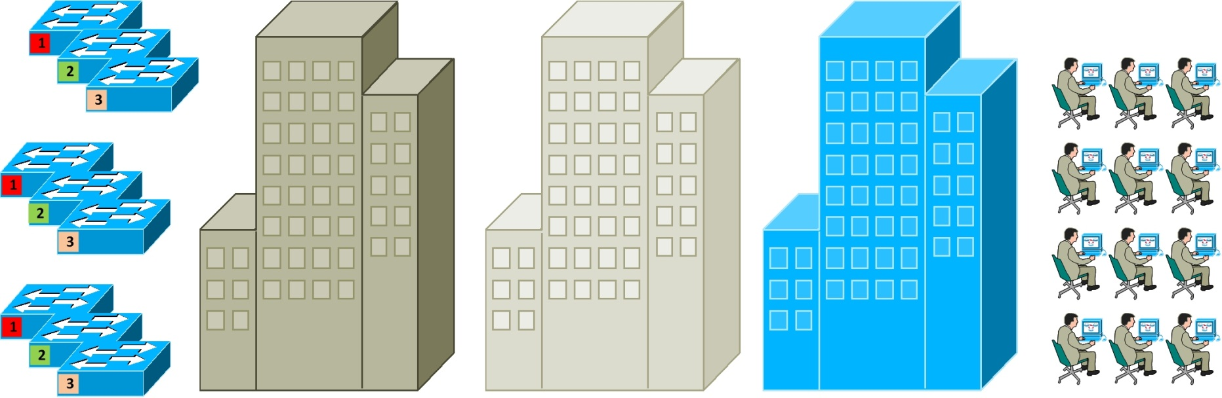
Switching Concepts
What is LAN?
Same Broadcast Domain
Same Subnet

Slide 9
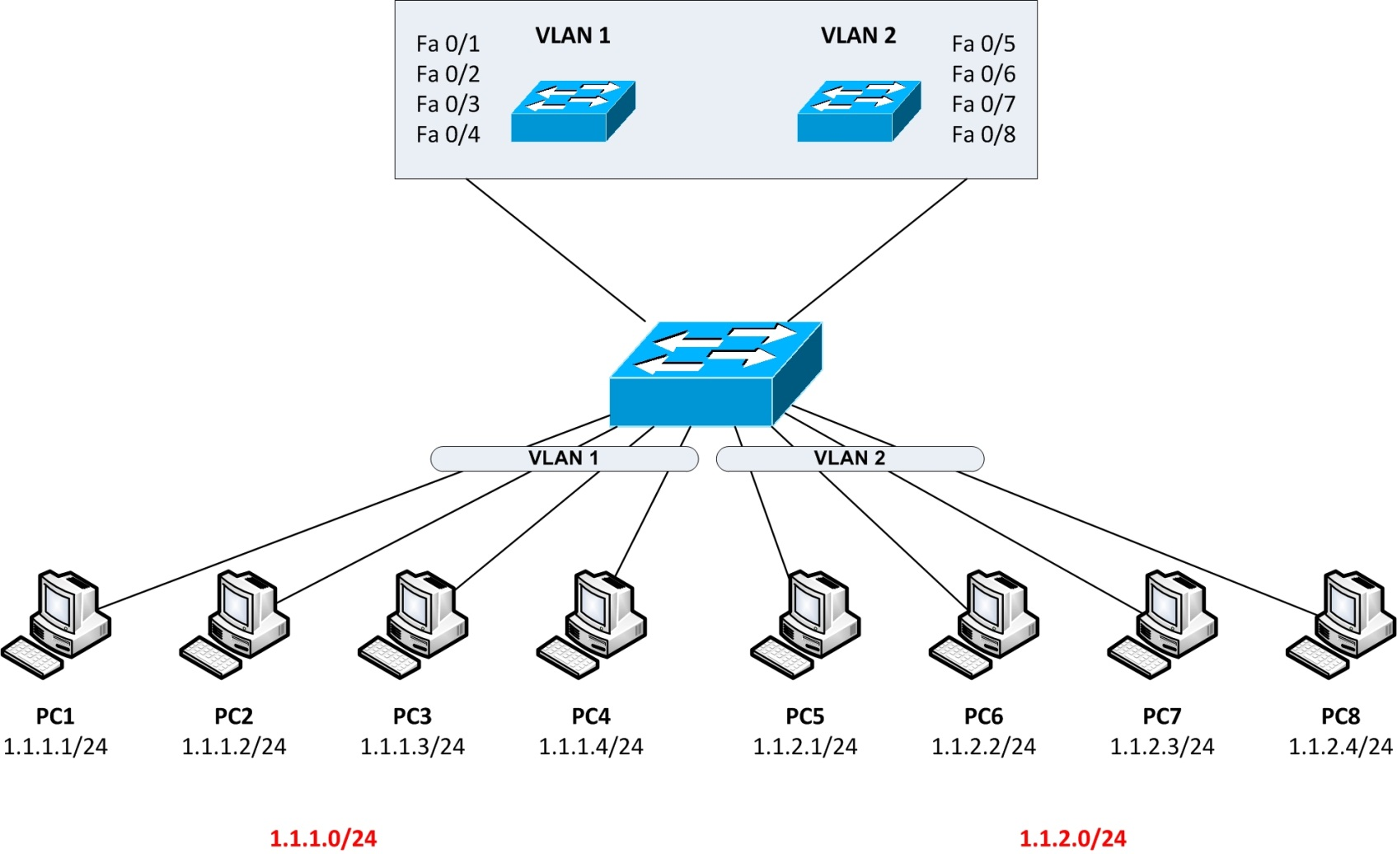
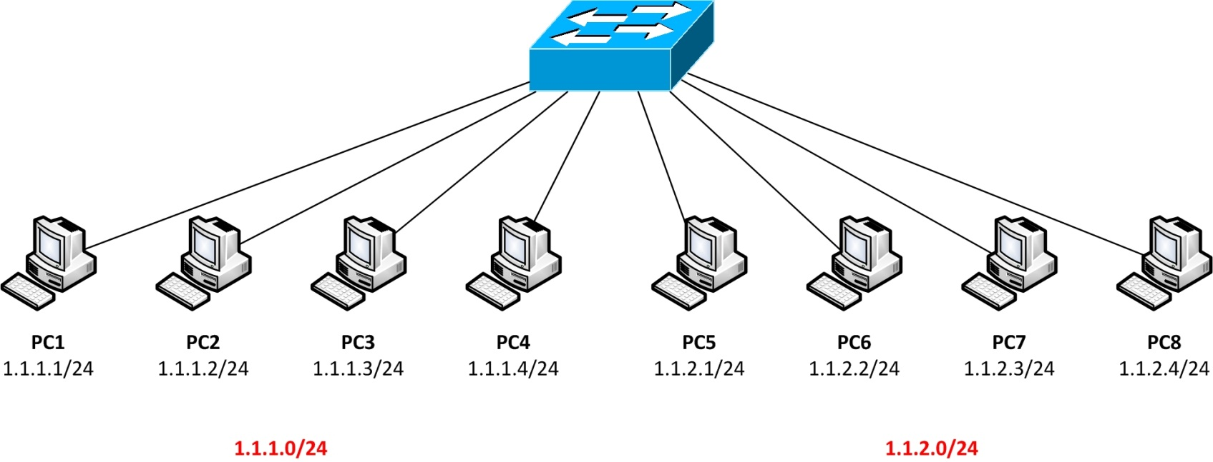
Switching Concepts
What is VLAN?
Same Broadcast Domain
Same Subnet

Slide 10
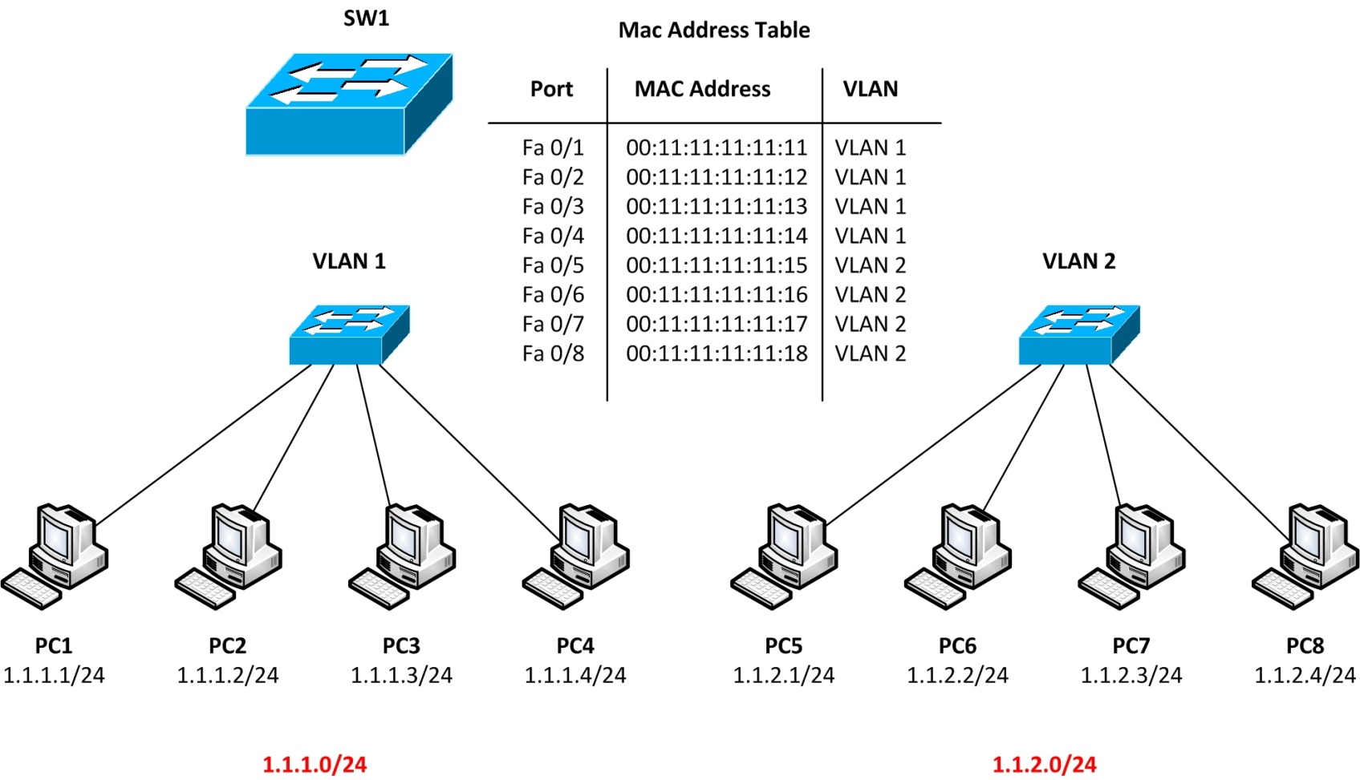
Switching Concepts
VLAN Benefits
Security
Reduce Broadcast Domain
Flexibility and Scalability

Slide 11
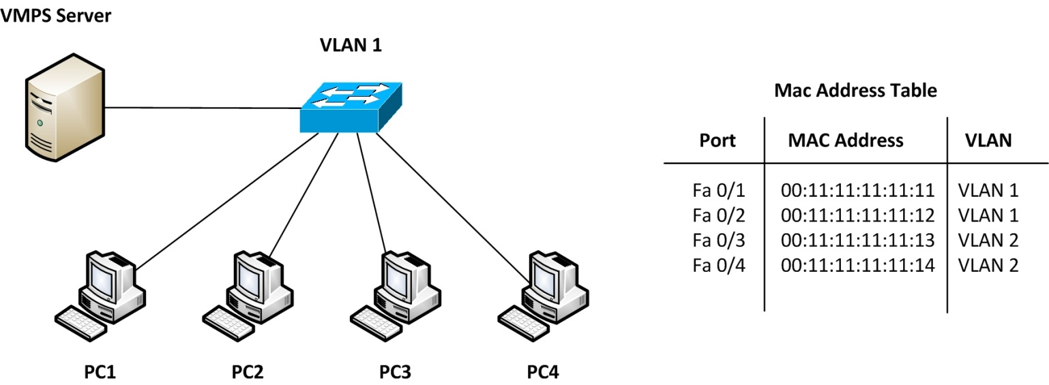
Switching Concepts
VLAN Membership
Static
Dynamic (VMPS)
Voice VLAN

Slide 12
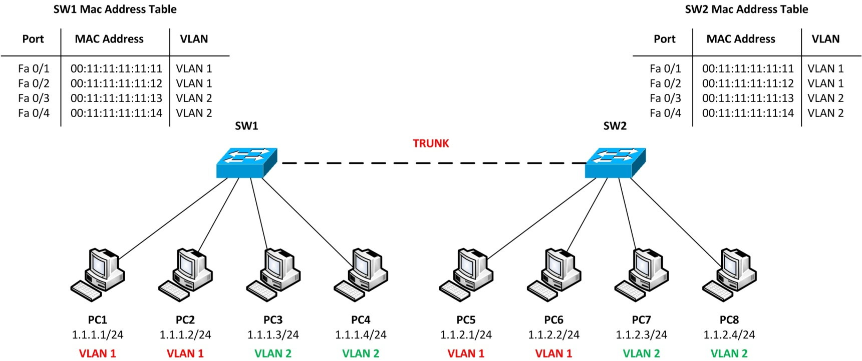
Switching Concepts
TRUNK
ISL (Inter Switch Link)
802.1Q

Slide 13
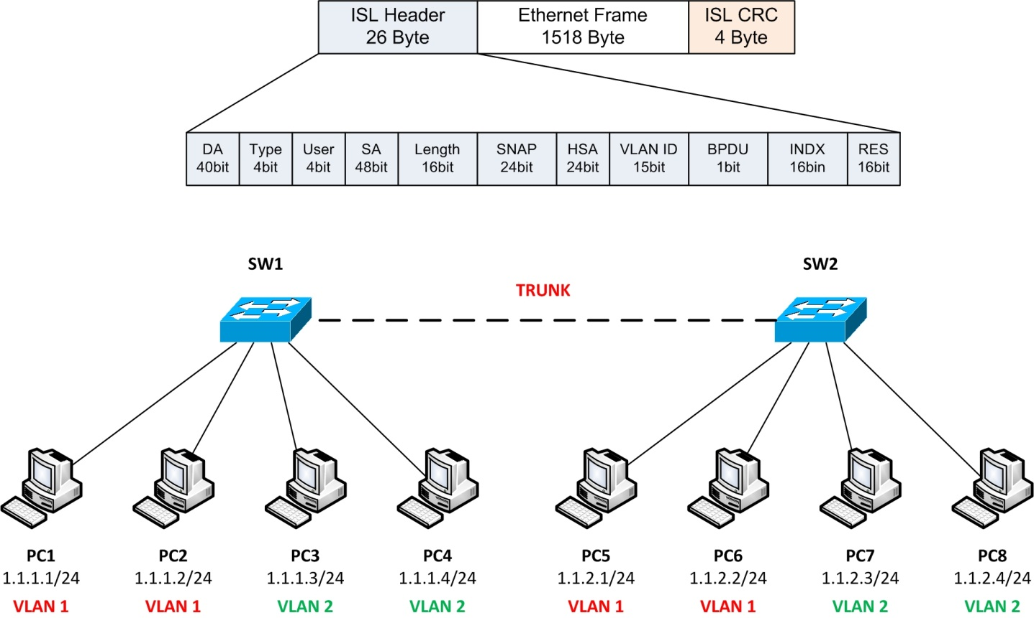
Switching Concepts
ISL (Inter Switch Link)
Cisco Proprietary
26 Byte Header
4 Byte CRC
VLAN ID
Support 4094 VLANs
1 – 1005 = Normal Range
>1005 = Extended Range

Slide 14
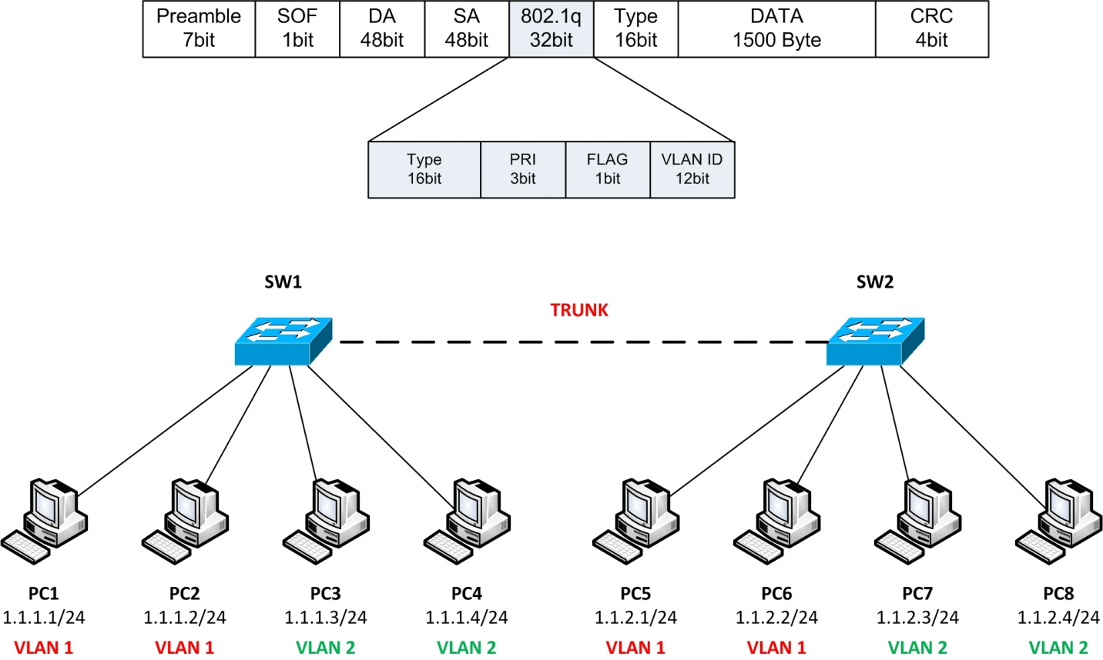
Switching Concepts
802.1Q
ISO Standard
4 Byte Tag
VLAN ID
Support 4094 VLANs
1 – 1005 = Normal Range
>1005 = Extended Range
Native VLAN

Slide 15
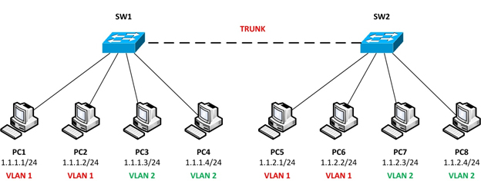
Switching Concepts
DTP (Dynamic Trunking Protocol)
Dynamic Mode
Desirable
Auto

Slide 16
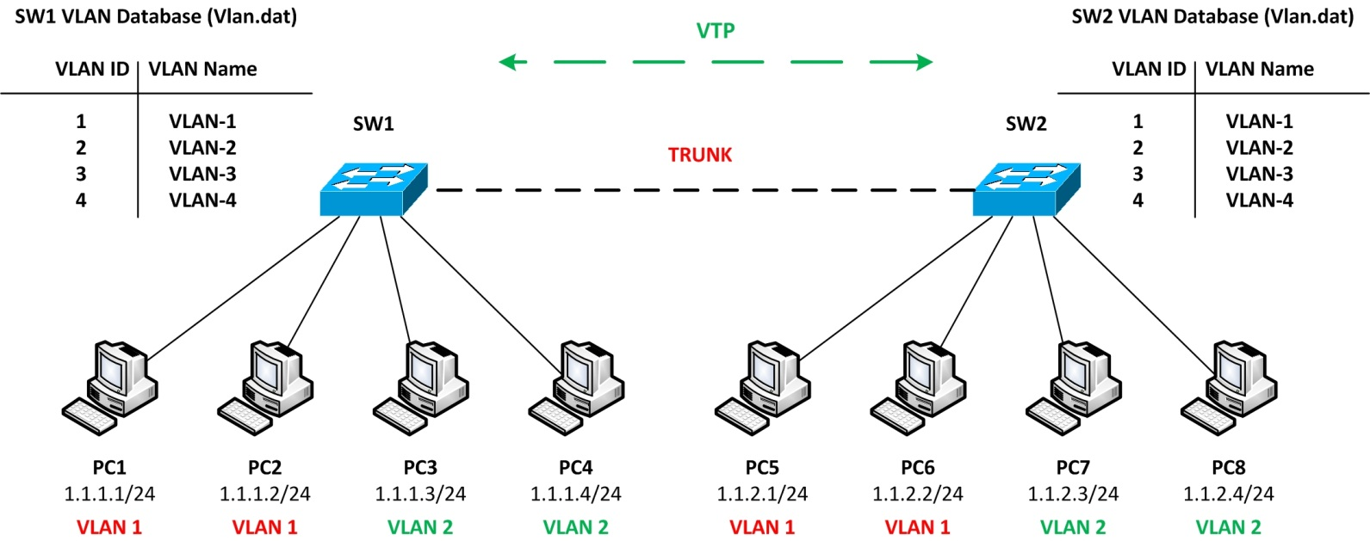
Switching Concepts
VTP (VLAN Trunking Protocol)
VTP Domain
VTP Mode
Server
Client
Transparent
VTP Password

Slide 17
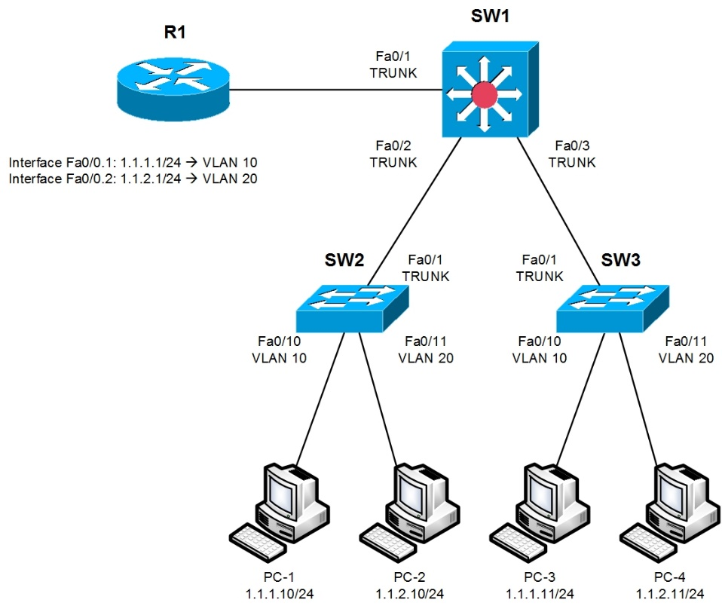
Switching Concepts
Inter VLAN Routing
Router on a stick
Subinterface
Inter VLAN Routing
Interface Vlan

Slide 18
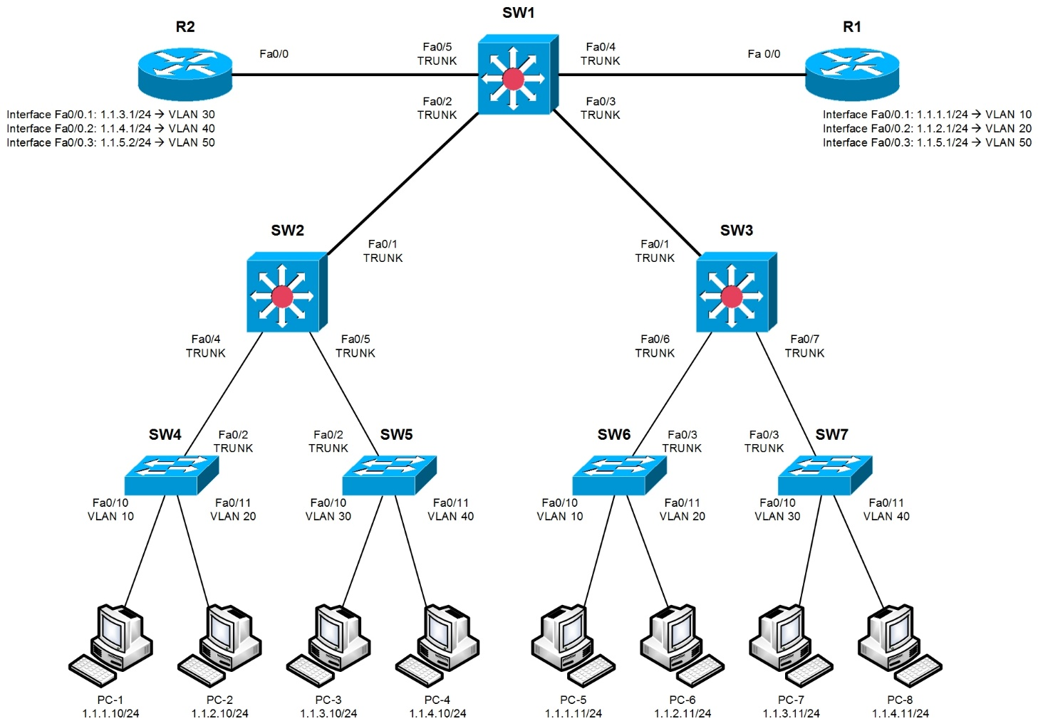
Switching Concepts
Inter VLAN Routing
Router on a stick
Subinterface
Inter VLAN Routing
Interface Vlan

Slide 19
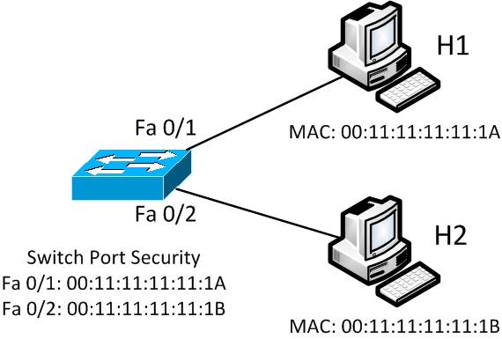
Switching Concepts
Port Security
Violation:
1- Shutdown
2- Restrict
3- Protect

Slide 20
Switching Basic
Switching Concepts

